Slide 1
Mobile Development :
4 : Android Native Development : Part 2 More on Layouts, Navigation, Intents, Adapters
Professor Imed Bouchrika National School of Artificial Intelligence imed.bouchrika@ensia.edu.dz

Slide 2
Outline :
Section 1 :
More on :
Layouts and Widgets and Adapters
Navigations :
Creating multiple Screens and Activities
Intents and Callbacks
Threads for Android Apps
Section 2 :
Example : Snake Game

Slide 3
Recap for Week 3: Getting Started Dev on Android
Introduction to Android + Stack of OS Layers
Programming using Android and Kotlin
Two Demo Apps:
Incrementing a number
Tic Tac Toe
Kotlin OOP

Slide 4
Section 1
Basics for Android Development

Slide 5
Layouts for Building Android Screens
Linear Layout :
<LinearLayout xmlns:android="http://schemas.android.com/apk/res/android"
xmlns:app="http://schemas.android.com/apk/res-auto"
xmlns:tools="http://schemas.android.com/tools"
android:layout_width="match_parent"
android:layout_height="match_parent"
android:orientation="vertical"
android:gravity="center"

Slide 6
Layouts for Building Android Screens
<RelativeLayout
android:layout_width="match_parent"
android:layout_height="match_parent">
<TextView
android:id="@+id/tx_name"
android:lay out_width="wrap_content"
android:layout_height="wrap_content"
android:layout_alignParentTop="true"
android:layout_centerHorizontal="true"
android:text="EXPENSE NAME"
android:textStyle="bold" />
<TextView
android:id="@+id/tx_date"
android:layout_width="wrap_content"
android:layout_height="wrap_content"
android:layout_below="@id/tx_name"
android:layout_marginTop="2dp"
android:layout_marginRight="5dp"
android:text="DATE"
android:textColor="@android:color/black"
android:textSize="20sp" />
Constrained Layout or RelativeLayout:

Slide 7
Layouts for Building Android Screens
<TableLayout
android:id="@+id/mainBoard"
android:layout_width="wrap_content"
android:layout_height="wrap_content"
android:layout_gravity="top|center"
android:gravity="center"
android:layout_marginTop="100dp"
android:padding="10dp">
<TableRow
android:id="@+id/row0"
style="@style/TableRow"
android:layout_width="match_parent"
android:layout_height="match_parent">
<TextView
android:id="@+id/tx_a1"
style="@style/LeftCell"
android:width="50dp"
…
Table Layout :

Slide 8
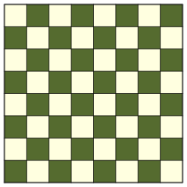
Widgets for Building Android Screens
Welcome to Board
How to make a grid of alternating colored cells dynamically :
(Without using an image)
Size can be 4x4 or 10x10 or 50x50 ?
4x4 Board
10x10 Board

Slide 9
Widgets for Building Android Screens
Welcome to Board
How to make a grid of alternating colored cells dynamically :
(Without using an image)
Size can be 4x4 or 10x10 or 50x50 ?
What’s the structure for the XML ?
4x4 Board
10x10 Board

Slide 10
Widgets for Building Android Screens
Welcome to Board
How to make a grid of alternating colored cells dynamically :
LinearLayout (Vertical)
TextView
LinearLayout ( Vertical )
LinearLayout ( Horizontal)
TextViews or Buttons or …
Button
Button
4x4 Board
10x10 Board

Slide 11
Widgets for Building Android Screens
<?xml version="1.0" encoding="utf-8"?>
<LinearLayout xmlns:android="http://schemas.android.com/apk/res/android"
xmlns:app="http://schemas.android.com/apk/res-auto"
xmlns:tools="http://schemas.android.com/tools"
android:layout_width="match_parent"
android:layout_height="match_parent"
android:orientation="vertical"
android:gravity="center"
tools:context=".MainActivity">
<TextView
android:id="@+id/tx_welcome"
android:layout_width="wrap_content"
android:layout_height="wrap_content"
android:text="Welcome to Board"
android:layout_marginTop="10dp" />
<LinearLayout
android:id="@+id/lt_board"
android:layout_width="wrap_content"
android:layout_height="wrap_content"
android:layout_marginTop="10dp"
android:orientation="vertical">
</LinearLayout>
<Button
android:id="@+id/bt_board8"
android:layout_width="wrap_content"
android:layout_height="wrap_content"
android:text="8x8 Board"
android:layout_marginTop="10dp"/>
</LinearLayout>
Welcome to Board
How to make a grid of alternating colored cells dynamically :
LinearLayout (Vertical)
TextView
LinearLayout ( Vertical )
LinearLayout ( Horizontal)
TextViews or Buttons or …
Button
Button
4x4 Board
10x10 Board

Slide 12
Widgets for Building Android Screens
Welcome to Board
class MainActivity : AppCompatActivity() {
override fun onCreate(savedInstanceState: Bundle?) {
super.onCreate(savedInstanceState)
setContentView(R.layout.activity_main)
var bt_board8=findViewById<Button>(R.id.bt_board8)
bt_board8.setOnClickListener {
buildGrid(8)
}
}
private fun buildGrid(number: Int){
println("Thinking of how to create the Board ?")
}
}
4x4 Board
Simplify : Let’s start with single colored column
10x10 Board

Slide 13
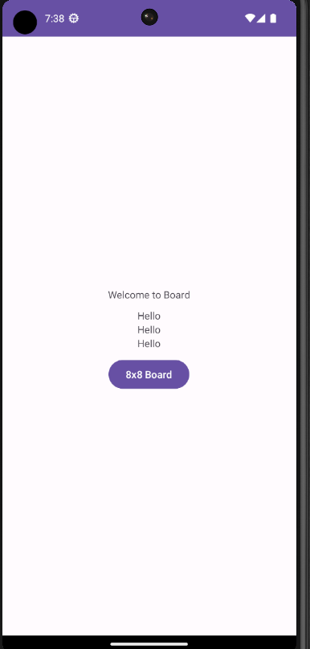
Widgets for Building Android Screens
Welcome to Board
private fun buildGrid(number: Int){
var lt_board=findViewById<LinearLayout>(R.id.lt_board)
var tx_cell=TextView(this)
tx_cell.setText("Hello")
lt_board.addView(tx_cell)
}
4x4 Board
10x10 Board

Slide 14
Widgets for Building Android Screens
Welcome to Board
Create a Layout File for a Colored Cell using TextView :
Right Click Layout
New
XML
Layout XML File
RootTag : TextView
Layout File name : any text in small letters
4x4 Board
10x10 Board

Slide 15
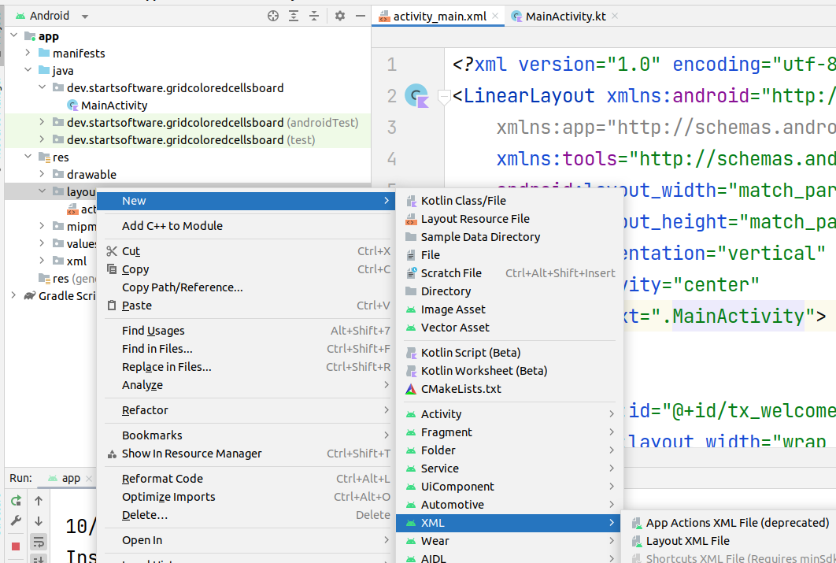
Widgets for Building Android Screens
Welcome to Board
Create a Layout File for a Colored Cell using TextView :
Right Click Layout
New
XML
Layout XML File
RootTag : TextView
Layout File name : any text in small letters
4x4 Board
10x10 Board

Slide 16
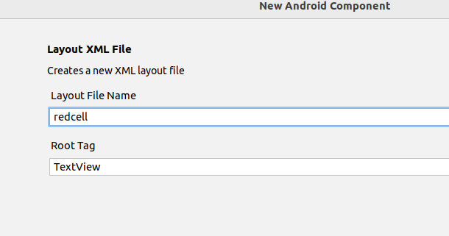
Widgets for Building Android Screens
Welcome to Board
Create a Layout File for a Colored Cell using TextView :
Right Click Layout
New
XML
Layout XML File
RootTag : TextView
Layout File name : any text in small letters
4x4 Board
10x10 Board

Slide 17
Widgets for Building Android Screens
<?xml version="1.0" encoding="utf-8"?>
<TextView xmlns:android="http://schemas.android.com/apk/res/android"
android:layout_width="10dp"
android:layout_height="10dp"
android:width="10dp"
android:height="10dp"
android:background="#ff0000"
android:lineHeight="10dp"
android:text=" "></TextView>
How to make a grid of alternating colored cells dynamically :
Create the XML View :
?
4x4 Board
10x10 Board

Slide 18
Widgets for Building Android Screens
private fun buildGrid(number: Int){
var lt_board = findViewById<LinearLayout>(R.id.lt_board)
var tx_cell = layoutInflater.inflate(R.layout.redcell, null) as TextView
lt_board.addView(tx_cell)
}
4x4 Board
10x10 Board

Slide 19
Widgets for Building Android Screens
How to alternate ?
private fun buildGrid(number: Int){
var lt_board = findViewById<LinearLayout>(R.id.lt_board)
var tx_cell = layoutInflater.inflate(R.layout.redcell, null) as TextView
lt_board.addView(tx_cell)
}
4x4 Board
10x10 Board

Slide 20
Widgets for Building Android Screens
Alternating Colors of TextViews :
Create another Layout File for the Blue Cells containing a TextView
In code : using Mod Function
4x4 Board
10x10 Board

Slide 21
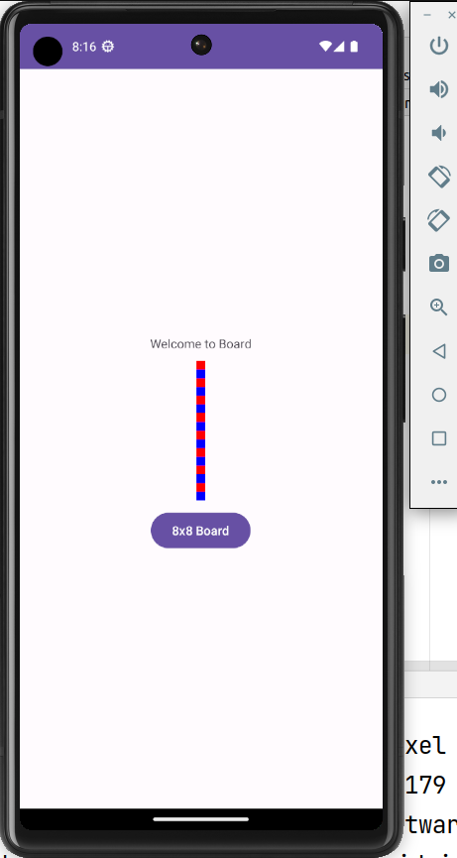
Widgets for Building Android Screens
private fun buildGrid(number: Int){
var lt_board=findViewById<LinearLayout>(R.id.lt_board)
lt_board.removeAllViews()
for (i in 0..number-1) {
var tx_cell : TextView?
if (i %2 ==0) {
tx_cell = layoutInflater.inflate(R.layout.redcell, null) as TextView
}else{
tx_cell = layoutInflater.inflate(R.layout.bluecell, null) as TextView
}
lt_board.addView(tx_cell)
}
}
4x4 Board
10x10 Board

Slide 22
Widgets for Building Android Screens
private fun buildGrid(number: Int){
var lt_board=findViewById<LinearLayout>(R.id.lt_board)
lt_board.removeAllViews()
for (i in 0..number-1) {
var tx_cell : TextView?
if (i %2 ==0) {
tx_cell = layoutInflater.inflate(R.layout.redcell, null) as TextView
}else{
tx_cell = layoutInflater.inflate(R.layout.bluecell, null) as TextView
}
lt_board.addView(tx_cell)
}
}
Let’s make the Board ?
4x4 Board
10x10 Board

Slide 23
Widgets for Building Android Screens
Creating the Board :
Creating a Layout for the Horizontal LinearLayout items
Making two inner loops to add LinearLayout First And inside each LinearLayout, we add the Cells.
4x4 Board
10x10 Board

Slide 24
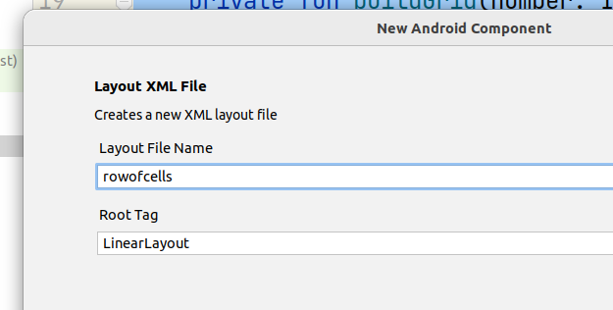
Widgets for Building Android Screens
Creating the Board :
Creating a Layout for the Horizontal LinearLayout items
Making two inner loops to add LinearLayout First And inside each LinearLayout, we add the Cells.
<?xml version="1.0" encoding="utf-8"?>
<LinearLayout xmlns:android="http://schemas.android.com/apk/res/android"
android:layout_width="wrap_content"
android:orientation="horizontal"
android:layout_height="wrap_content">
</LinearLayout>
4x4 Board
10x10 Board

Slide 25
Widgets for Building Android Screens
private fun buildGrid(number: Int){
var lt_board=findViewById<LinearLayout>(R.id.lt_board)
lt_board.removeAllViews()
for (row in 0..number-1) {
var lt_row = layoutInflater.inflate(R.layout.rowofcells, null) as LinearLayout
for (col in 0..number-1) {
var tx_cell: TextView?
if (row % 2 == col %2) {
tx_cell = layoutInflater.inflate(R.layout.redcell, null) as TextView
} else {
tx_cell = layoutInflater.inflate(R.layout.bluecell, null) as TextView
}
lt_row.addView(tx_cell)
}
lt_board.addView(lt_row)
}
}
Creating the Board :
Creating a Layout for the Horizontal LinearLayout items
Making two inner loops to add LinearLayout First And inside each LinearLayout, we add the Cells.
???
4x4 Board
10x10 Board

Slide 26
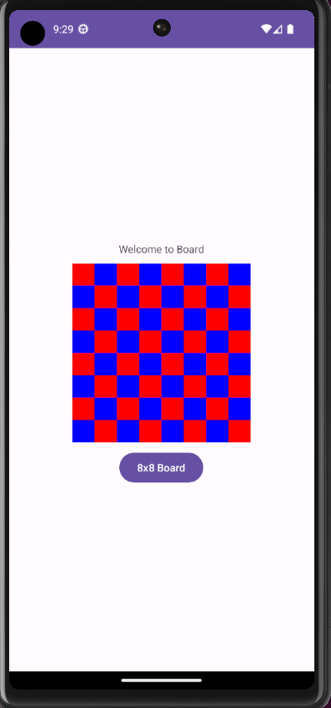
Widgets for Building Android Screens
private fun buildGrid(number: Int){
var lt_board=findViewById<LinearLayout>(R.id.lt_board)
lt_board.removeAllViews()
for (row in 0..number-1) {
var lt_row = layoutInflater.inflate(R.layout.rowofcells, null) as LinearLayout
for (col in 0..number-1) {
var tx_cell: TextView?
if (row % 2 == col %2) {
tx_cell = layoutInflater.inflate(R.layout.redcell, null) as TextView
} else {
tx_cell = layoutInflater.inflate(R.layout.bluecell, null) as TextView
}
lt_row.addView(tx_cell)
}
lt_board.addView(lt_row)
}
}
Creating the Board :
Creating a Layout for the Horizontal LinearLayout items
Making two inner loops to add LinearLayout First And inside each LinearLayout, we add the Cells.
4x4 Board
10x10 Board

Slide 27
Navigation Between Screens
How to make the following Expenses App :
New Expense
Expenses App
Description
New Expense
Amount
List of Expenses
Date
Add

Slide 28
Navigation Between Screens
Expenses App
New Expense
List of Expenses
How to make the following Expenses App :
Create the XML Layout for the home Screen:
LinearLayout (Vertical)
LinearLayout (Vertical):
TextView + Button + Button
LinearLayout(Vertical)
TextView + TextField + TextField + …
New Expense
Description
Amount
Date
Add

Slide 29
Navigation Between Screens
Expenses App
New Expense
List of Expenses
How to make the following Expenses App :
Create the XML Layout for the home Screen:
LinearLayout (Vertical)
LinearLayout (Vertical):
TextView + Button + Button
LinearLayout(Vertical)
TextView + TextField + TextField + …
Navigation : On clicking a button : You set the visibility true to the corresponding layout whilst other layout are set invisible ?
New Expense
Description
Amount
Date
Add

Slide 30
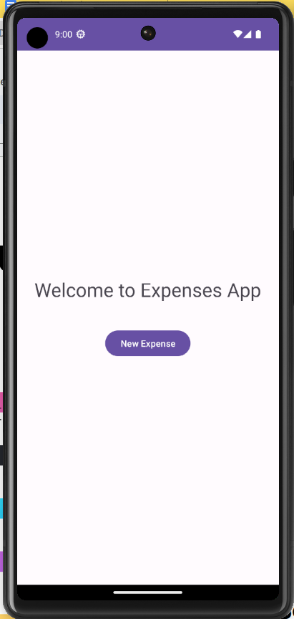
Navigation Between Screens
Expenses App
New Expense
List of Expenses
How to make the following Expenses App :
Start with the Home Screen as the MainActivity
Construct the UI using the XML file
Upon Clicking the button : New Expense
Do nothing for now ?
New Expense
Description
class MainActivity : AppCompatActivity() {
override fun onCreate(savedInstanceState: Bundle?) {
super.onCreate(savedInstanceState)
setContentView(R.layout.activity_main)
var bt_new=findViewById<Button>(R.id.bt_new)
bt_new.setOnClickListener {
println("New Expense button is clicked ! ")
}
}
Amount
Date
Add

Slide 31
Navigation Between Screens
Expenses App
New Expense
List of Expenses
How to make the following Expenses App :
Start with the Home Screen as the MainActivity
Construct the UI using the XML file
Upon Clicking the button : New Expense
Do nothing for now ?
Create New Activity : NewExpense We will be using INTENTs
New Expense
Description
class MainActivity : AppCompatActivity() {
override fun onCreate(savedInstanceState: Bundle?) {
super.onCreate(savedInstanceState)
setContentView(R.layout.activity_main)
var bt_new=findViewById<Button>(R.id.bt_new)
bt_new.setOnClickListener {
println("New Expense button is clicked ! ")
}
}
Amount
Date
Add

Slide 32
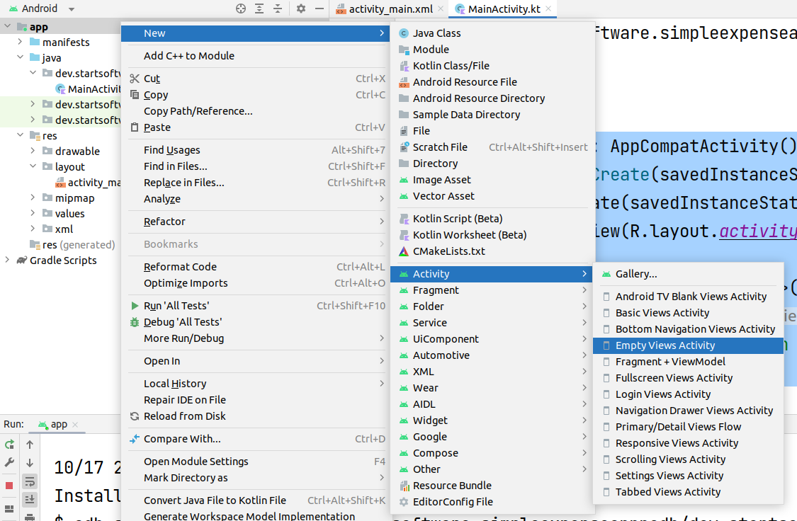
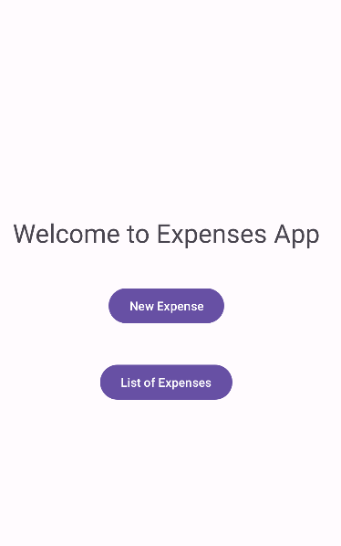
Widgets for Building Android Screens
Expenses App
New Expense
List of Expenses
How to make the following Expenses App :
Start with the Home Screen as the MainActivity
Construct the UI using the XML file
Upon Clicking the button : New Expense
Do nothing for now ?
Create New Activity : NewExpense We will be using INTENTs
New Expense
Description
class MainActivity : AppCompatActivity() {
override fun onCreate(savedInstanceState: Bundle?) {
super.onCreate(savedInstanceState)
setContentView(R.layout.activity_main)
var bt_new=findViewById<Button>(R.id.bt_new)
bt_new.setOnClickListener {
println("New Expense button is clicked ! ")
}
}
Amount
Date
Add

Slide 33
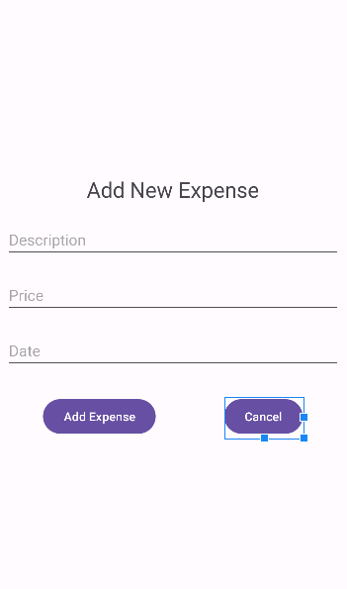
Navigation Between Screens
Expenses App
New Expense
List of Expenses
How to make the following Expenses App :
For the NewExpense Activity:
Do the design of the UI on the XML
Clicking the button Add Expense
Save to a local variable, no need for A database for now.
Clicking the button : Cancel ?
Takes back to Home/Main Activity Screen
New Expense
Description
Amount
Date
Add

Slide 34
Widgets for Building Android Screens
<?xml version="1.0" encoding="utf-8"?>
<LinearLayout xmlns:android="http://schemas.android.com/apk/res/android"
xmlns:app="http://schemas.android.com/apk/res-auto"
xmlns:tools="http://schemas.android.com/tools"
android:layout_width="match_parent"
android:layout_height="match_parent"
android:orientation="vertical"
android:gravity="center"
tools:context=".NewExpense">
<TextView
android:layout_width="wrap_content"
android:layout_height="wrap_content"
android:text="Add New Expense"
android:textSize="25sp"
android:layout_marginTop="10dp"
android:layout_marginBottom="10dp"
/>
<EditText
android:id="@+id/tx_description"
android:layout_width="match_parent"
android:layout_height="wrap_content"
android:ems="10"
android:layout_margin="10dp"
android:inputType="text"
android:hint="Description"
/>
<EditText
android:id="@+id/tx_amout"
android:layout_width="match_parent"
android:layout_height="wrap_content"
android:ems="10"
android:layout_margin="10dp"
android:inputType="numberDecimal"
android:hint="Price"
/>
<EditText
android:id="@+id/tx_date"
android:layout_width="match_parent"
android:layout_height="wrap_content"
android:ems="10"
android:layout_margin="10dp"
android:inputType="date"
android:hint="Date"
/>
<LinearLayout
android:layout_width="wrap_content"
android:layout_height="wrap_content"
android:orientation="horizontal">
<Button
android:id="@+id/bt_add"
android:layout_width="wrap_content"
android:layout_height="wrap_content"
android:text="Add Expense"
android:layout_marginTop="20dp"
android:layout_marginBottom="20dp"
android:layout_marginRight="40dp"
android:layout_marginLeft="40dp"
/>
<Button
android:id="@+id/bt_cancel"
android:layout_width="wrap_content"
android:layout_height="wrap_content"
android:layout_marginLeft="40dp"
android:layout_marginTop="20dp"
android:layout_marginRight="40dp"
android:layout_marginBottom="20dp"
android:text="Cancel" />
</LinearLayout>
</LinearLayout>
Expenses App
<EditText
android:id="@+id/tx_amout"
android:layout_width="match_parent"
android:layout_height="wrap_content"
android:ems="10"
android:layout_margin="10dp"
android:inputType="numberDecimal"
android:hint="Price"
/>
<EditText
android:id="@+id/tx_date"
android:layout_width="match_parent"
android:layout_height="wrap_content"
android:ems="10"
android:layout_margin="10dp"
android:inputType="date"
android:hint="Date"
/>
<LinearLayout
android:layout_width="wrap_content"
android:layout_height="wrap_content"
android:orientation="horizontal">
<Button
android:id="@+id/bt_add"
android:layout_width="wrap_content"
android:layout_height="wrap_content"
android:text="Add Expense"
android:layout_marginTop="20dp"
android:layout_marginBottom="20dp"
android:layout_marginRight="40dp"
android:layout_marginLeft="40dp"
/>
<Button
android:id="@+id/bt_cancel"
android:layout_width="wrap_content"
android:layout_height="wrap_content"
android:layout_marginLeft="40dp"
android:layout_marginTop="20dp"
android:layout_marginRight="40dp"
android:layout_marginBottom="20dp"
android:text="Cancel" />
</LinearLayout>
</LinearLayout>
New Expense
List of Expenses
How to make the following Expenses App :
For the NewExpense Activity:
Do the design of the UI on the XML
Clicking the button Add Expense
Save to a local variable, no need for A database for now.
Clicking the button : Cancel ?
Takes back to Home/Main Activity Screen
New Expense
Description
Amount
Date
Add

Slide 35
Navigation Between Screens
Expenses App
New Expense
Inside the MainActivity
List of Expenses
How to make the following Expenses App :
Start with the Home Screen as the MainActivity
Construct the UI using the XML file
Upon Clicking the button : New Expense
Do nothing for now
Create another Activity : NewExpense
override fun onCreate(savedInstanceState: Bundle?) {
super.onCreate(savedInstanceState)
setContentView(R.layout.activity_main)
var bt_new=findViewById<Button>(R.id.bt_new)
bt_new.setOnClickListener {
val intent = Intent(this, NewExpense::class.java)
intent.putExtra("some_variable", "HelloWorld !")
intent.putExtra("another_variable", 12)
this.startActivity(intent)
}
}
New Expense
Description
Amount
Date
Add

Slide 36
Navigation Between Screens
Expenses App
New Expense
List of Expenses
An intent is an object representing some action to be performed.
Common Action : Launch another activity
How to make the following Expenses App :
Start with the Home Screen as the MainActivity
Construct the UI using the XML file
Upon Clicking the button : New Expense
Do nothing for now
Create another Activity : NewExpense
override fun onCreate(savedInstanceState: Bundle?) {
super.onCreate(savedInstanceState)
setContentView(R.layout.activity_main)
var bt_new=findViewById<Button>(R.id.bt_new)
bt_new.setOnClickListener {
val intent = Intent(this, NewExpense::class.java)
intent.putExtra("some_variable", "HelloWorld !")
intent.putExtra("another_variable", 12)
this.startActivity(intent)
}
}
New Expense
Description
Amount
Date
Add

Slide 37
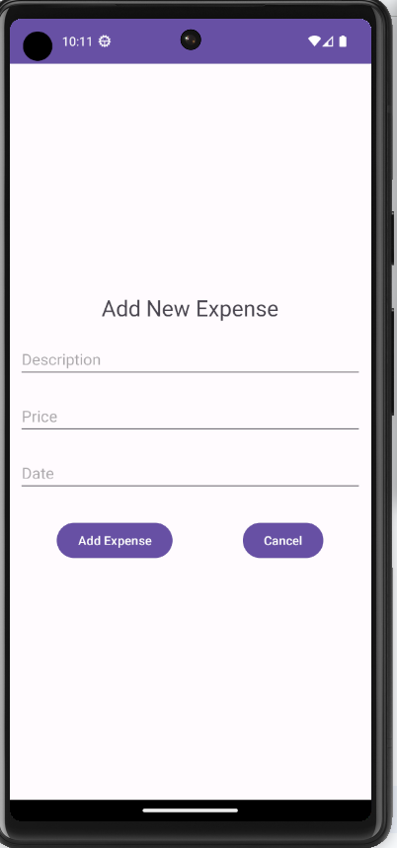
Navigation Between Screens
Expenses App
New Expense
List of Expenses
How to make the following Expenses App :
Start with the Home Screen as the MainActivity
Construct the UI using the XML file
Upon Clicking the button : New Expense
Do nothing for now
Create another Activity : NewExpense
override fun onCreate(savedInstanceState: Bundle?) {
super.onCreate(savedInstanceState)
setContentView(R.layout.activity_main)
var bt_new=findViewById<Button>(R.id.bt_new)
bt_new.setOnClickListener {
val intent = Intent(this, NewExpense::class.java)
intent.putExtra("some_variable", "HelloWorld !")
intent.putExtra("another_variable", 12)
this.startActivity(intent)
}
}
New Expense
Description
Amount
Android keeps a stack for the activities when we navigate through them
Date
Add

Slide 38
Navigation Between Screens
Expenses App
New Expense
List of Expenses
How to make the following Expenses App :
Start with the Home Screen as the MainActivity
Construct the UI using the XML file
Upon Clicking the button : New Expense
Do nothing for now
Create another Activity : NewExpense
override fun onCreate(savedInstanceState: Bundle?) {
super.onCreate(savedInstanceState)
setContentView(R.layout.activity_main)
var bt_new=findViewById<Button>(R.id.bt_new)
bt_new.setOnClickListener {
val intent = Intent(this, NewExpense::class.java)
intent.putExtra("some_variable", "HelloWorld !")
intent.putExtra("another_variable", 12)
this.startActivity(intent)
}
}
New Expense
Description
How to implement the business Logic Cancel Button for the case where users don’t have a back button ?
Amount
Date
Add

Slide 39
Navigation Between Screens
Expenses App
New Expense
List of Expenses
How to make the following Expenses App :
Start with the Home Screen as the MainActivity
Construct the UI using the XML file
Upon Clicking the button : New Expense
Do nothing for now
Create another Activity : NewExpense
class NewExpense : AppCompatActivity() {
override fun onCreate(savedInstanceState: Bundle?) {
super.onCreate(savedInstanceState)
setContentView(R.layout.activity_new_expense)
var bt_cancel=findViewById<Button>(R.id.bt_cancel)
bt_cancel.setOnClickListener {
this.finish()
}
}
}
New Expense
Description
Amount
Date
Add

Slide 40
Navigation Between Screens
Expenses App
New Expense
List of Expenses
How to make the following Expenses App :
For simplicity, we will not be using databases.
Expenses are added to a Vector Object
Class Expense needs to be Created.
Upon clicking the method Add Expense
?
?
?
New Expense
Description
Amount
Date
Add

Slide 41
Navigation Between Screens
Expenses App
New Expense
List of Expenses
How to make the following Expenses App :
For simplicity, we will not be using databases.
Expenses are added to a Vector Object
Class Expense needs to be Created.
Upon clicking the method Add Expense
Store the Expense Object into the Vector
Finish the Child Activity to go Back
Refresh the Screen UI of the Parent Activity
New Expense
Description
Amount
Date
Add

Slide 42
Navigation Between Screens
Expenses App
New Expense
List of Expenses
How to make the following Expenses App :
Store the Expense Object into the Vector
Expense Class
New Expense
1
Description
package dev.startsoftware.simpleexpenseappnodb
class Expense(var name:String,var Date:String,var price:Double)
Amount
Date
Add
Kotlin does not have the static keyword ?

Slide 43
Navigation Between Screens
Expenses App
New Expense
List of Expenses
How to make the following Expenses App :
Store the Expense Object into the Vector
Inside the Parent Class : MainActivity
New Expense
1
Description
class MainActivity : AppCompatActivity() {
companion object {
var data = Vector<Expense>()
}
override fun onCreate(savedInstanceState: Bundle?) {
Amount
Date
Add
Kotlin does not have the static keyword ?

Slide 44
Navigation Between Screens
Expenses App
New Expense
List of Expenses
How to make the following Expenses App :
Store the Expense Object into the Vector
Inside the Child Activity
New Expense
1
Description
var bt_add=findViewById<Button>(R.id.bt_add)
bt_add.setOnClickListener {
var nameVal=findViewById<EditText>(R.id.tx_description).text.toString()
var dateVal=findViewById<EditText>(R.id.tx_description).text.toString()
var priceVal=findViewById<EditText>(R.id.tx_description).text.toString().toDouble()
MainActivity.data.add(Expense(nameVal,dateVal,priceVal))
this.finish()
}
Amount
Date
Add

Slide 45
Navigation Between Screens
Expenses App
New Expense
List of Expenses
How to make the following Expenses App :
Finish the Child Activity to go Back
Inside the Child Activity
New Expense
2
Description
var bt_add=findViewById<Button>(R.id.bt_add)
bt_add.setOnClickListener {
var nameVal=findViewById<EditText>(R.id.tx_description).text.toString()
var dateVal=findViewById<EditText>(R.id.tx_description).text.toString()
var priceVal=findViewById<EditText>(R.id.tx_description).text.toString().toDouble()
MainActivity.data.add(Expense(nameVal,dateVal,priceVal))
this.finish()
}
Amount
Date
Add

Slide 46
Navigation Between Screens
Expenses App
New Expense
List of Expenses
How to make the following Expenses App :
Refresh the Screen UI of the Parent Activity
Inside the Child Activity
New Expense
3
Description
For simplicity : Let’s print to the console the list of all expenses for now !
Amount
Date
Add

Slide 47
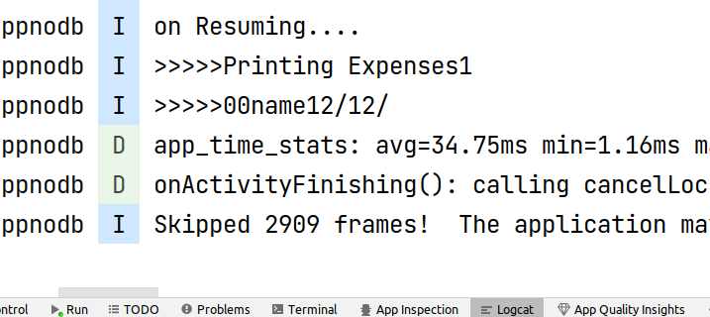
Navigation Between Screens
Expenses App
Every time, the activity is resumed : Business Logic is executed, CAN BE EXPENSIVE
New Expense
List of Expenses
How to make the following Expenses App :
Refresh the Screen UI of the Parent Activity
Inside the Parent Activity
New Expense
3
Description
class MainActivity : AppCompatActivity() {
override fun onResume() {
super.onResume()
println("on Resuming....")
for (item in data){
println(">>>>>"+item.name)
}
}
Amount
Date
Add

Slide 48
Navigation Between Screens
Expenses App
New Expense
Remember the use of INTENT
List of Expenses
How to make the following Expenses App :
Refresh the Screen UI of the Parent Activity
Inside the Parent Activity
val intent = Intent(this, NewExpense::class.java)
intent.putExtra("some_variable", "HelloWorld !")
intent.putExtra("another_variable", 12)
this.startActivity(intent)
New Expense
3
Description
Amount
Date
Add

Slide 49
Navigation Between Screens
Expenses App
New Expense
For the Child Activity
List of Expenses
How to make the following Expenses App :
this.finish()
New Expense
3
Description
Amount
val intent = Intent()
intent.putExtra("some_var_back", "AnyValueYouWant")
this.setResult(RESULT_OK, intent)
this.finish()
Date
Add

Slide 50
Navigation Between Screens
Expenses App
override fun onCreate(savedInstanceState: Bundle?) {
super.onCreate(savedInstanceState)
setContentView(R.layout.activity_main)
var bt_list=findViewById<Button>(R.id.bt_list)
bt_list.setOnClickListener {
printExpenses()
}
var bt_new=findViewById<Button>(R.id.bt_new)
bt_new.setOnClickListener {
val intent = Intent(this, NewExpense::class.java)
intent.putExtra("some_variable", "HelloWorld !")
intent.putExtra("another_variable", 12)
launchActivityNewExpense.launch(intent)
}
}
var launchActivityNewExpense = registerForActivityResult(
ActivityResultContracts.StartActivityForResult()) { result ->
if (result.resultCode == Activity.RESULT_OK) {
println("Get data back<<<<<<")
printExpenses()
}
}
For the Parent the use of Callbacks
New Expense
Remember the use of INTENT
List of Expenses
How to make the following Expenses App :
Refresh the Screen UI of the Parent Activity
Inside the Parent Activity
val intent = Intent(this, NewExpense::class.java)
intent.putExtra("some_variable", "HelloWorld !")
intent.putExtra("another_variable", 12)
this.startActivity(intent)
New Expense
3
Description
Amount
Date
Add

Slide 51
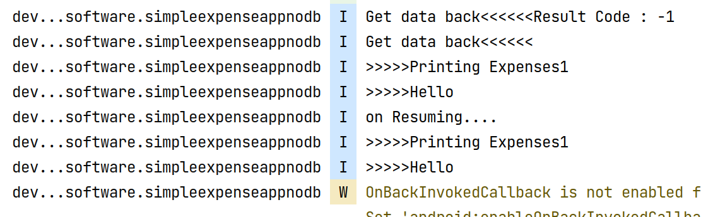
Navigation Between Screens
Expenses App
override fun onCreate(savedInstanceState: Bundle?) {
super.onCreate(savedInstanceState)
setContentView(R.layout.activity_main)
var bt_list=findViewById<Button>(R.id.bt_list)
bt_list.setOnClickListener {
printExpenses()
}
var bt_new=findViewById<Button>(R.id.bt_new)
bt_new.setOnClickListener {
val intent = Intent(this, NewExpense::class.java)
intent.putExtra("some_variable", "HelloWorld !")
intent.putExtra("another_variable", 12)
launchActivityNewExpense.launch(intent)
}
}
var launchActivityNewExpense = registerForActivityResult(
ActivityResultContracts.StartActivityForResult()) { result ->
if (result.resultCode == Activity.RESULT_OK) {
println("Get data back<<<<<<")
printExpenses()
}
}
The use of Callbacks
New Expense
Remember the use of INTENT
List of Expenses
How to make the following Expenses App :
Refresh the Screen UI of the Parent Activity
Inside the Parent Activity
val intent = Intent(this, NewExpense::class.java)
intent.putExtra("some_variable", "HelloWorld !")
intent.putExtra("another_variable", 12)
this.startActivity(intent)
New Expense
3
Description
Amount
Date
Add

Slide 52
Navigation Between Screens
Expenses App
New Expense
How to make the following Expenses App :
How to render the UI dynamically from the data structure ?
From a database in the Future ?
From an endpoint ?
Food at ABC
10/2023 10.0DZ
Gifts for Amel
10/2023 30.0DZ
Fuel for Car
10/2023 20.0DZ
Electricity Bill
10/2023 50.0DZ

Slide 53
Navigation Between Screens
Expenses App
New Expense
How to make the following Expenses App :
How to render the UI dynamically from the data structure ?
From a database in the Future ?
From an endpoint ?
We can create an XML Layout document for each Expense
In Kotlin :
For Loop for each item in Data
→ Inflate the XML document
→ Update View/Widget to set the data of expense item ( Name, Price, Date) → Add the Widget to the Parent View
Food at ABC
10/2023 10.0DZ
Gifts for Amel
10/2023 30.0DZ
Fuel for Car
10/2023 20.0DZ
Electricity Bill
10/2023 50.0DZ

Slide 54
Navigation Between Screens
Expenses App
New Expense
How to make the following Expenses App :
How to render the UI dynamically from the data structure ?
From a database in the Future ?
From an endpoint ?
Food at ABC
10/2023 10.0DZ
Gifts for Amel
10/2023 30.0DZ
Fuel for Car
10/2023 20.0DZ
Electricity Bill
10/2023 50.0DZ

Slide 55
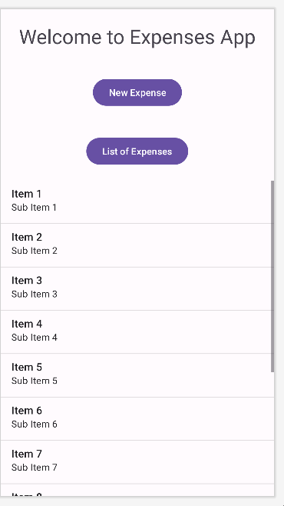
Navigation Between Screens
Expenses App
New Expense
How to make the following Expenses App :
We add to the Home Activity an Old ListView But each row?
needs to be customized and Re-adapted to specific data ?
Food at ABC
10/2023 10.0DZ
Gifts for Amel
10/2023 30.0DZ
Fuel for Car
10/2023 20.0DZ
Electricity Bill
10/2023 50.0DZ

Slide 56
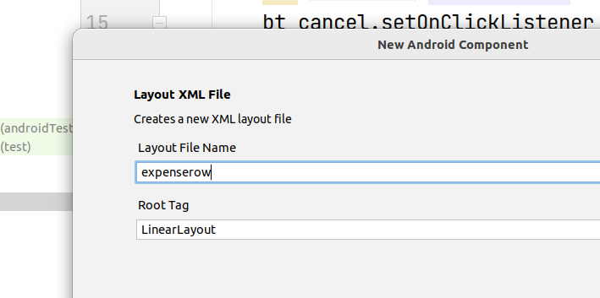
Navigation Between Screens
Expenses App
New Expense
How to make the following Expenses App :
Create a new Layout XML File for the expense row :
Food at ABC
10/2023 10.0DZ
Gifts for Amel
10/2023 30.0DZ
Fuel for Car
10/2023 20.0DZ
Electricity Bill
10/2023 50.0DZ

Slide 57
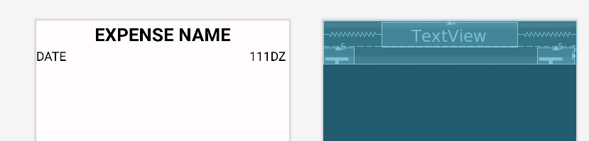
Navigation Between Screens
Expenses App
New Expense
How to make the following Expenses App :
We design using :
LinearLayout + RelativeLayout
Food at ABC
10/2023 10.0DZ
Gifts for Amel
10/2023 30.0DZ
Fuel for Car
10/2023 20.0DZ
Electricity Bill
10/2023 50.0DZ

Slide 58
Navigation Between Screens
<?xml version="1.0" encoding="utf-8"?>
<LinearLayout xmlns:android="http://schemas.android.com/apk/res/android"
android:layout_width="match_parent" android:orientation="vertical"
android:layout_height="wrap_content">
<RelativeLayout
android:layout_width="match_parent"
android:layout_height="match_parent">
<TextView
android:id="@+id/tx_name"
android:layout_width="wrap_content"
android:layout_height="wrap_content"
android:layout_alignParentTop="true"
android:layout_centerHorizontal="true"
android:layout_marginTop="2dp"
android:text="EXPENSE NAME"
android:textColor="@android:color/black"
android:textSize="30sp"
android:textStyle="bold" />
<TextView
android:id="@+id/tx_date"
android:layout_width="wrap_content"
android:layout_height="wrap_content"
android:layout_below="@id/tx_name"
android:layout_marginTop="2dp"
android:layout_marginRight="5dp"
android:text="DATE"
android:textColor="@android:color/black"
android:textSize="20sp" />
<TextView
android:id="@+id/tx_price"
android:layout_below="@id/tx_name"
android:layout_alignParentRight="true"
android:layout_width="wrap_content"
android:layout_height="wrap_content"
android:layout_marginTop="2dp"
android:layout_marginRight="5dp"
android:text="111DZ"
android:textColor="@android:color/black"
android:textSize="20sp"
/>
</RelativeLayout>
</LinearLayout>
Expenses App
<TextView
android:id="@+id/tx_price"
android:layout_below="@id/tx_name"
android:layout_alignParentRight="true"
android:layout_width="wrap_content"
android:layout_height="wrap_content"
android:layout_marginTop="2dp"
android:layout_marginRight="5dp"
android:text="111DZ"
android:textColor="@android:color/black"
android:textSize="20sp"
/>
</RelativeLayout>
</LinearLayout>
New Expense
How to make the following Expenses App :
We design using :
LinearLayout + RelativeLayout
Food at ABC
10/2023 10.0DZ
Gifts for Amel
10/2023 30.0DZ
Fuel for Car
10/2023 20.0DZ
Electricity Bill
10/2023 50.0DZ

Slide 59
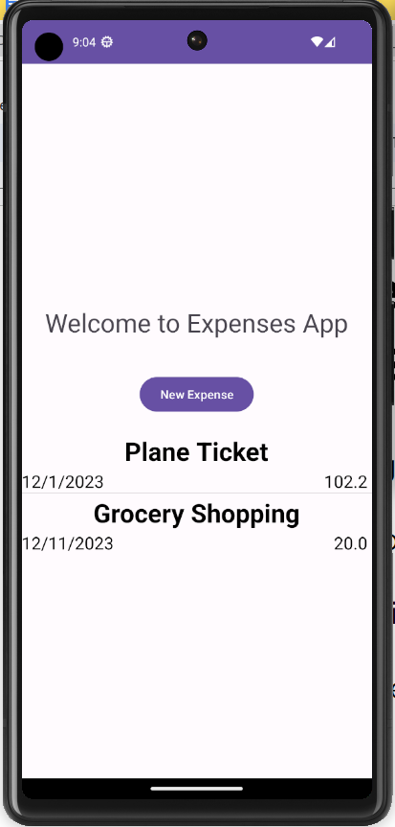
Navigation Between Screens
Expenses App
New Expense
How to make the following Expenses App :
Kotlin Code is written for the Adapter
Everytime, an expense is added, a refresh For the UI state is invoked.
Food at ABC
10/2023 10.0DZ
Gifts for Amel
10/2023 30.0DZ
Fuel for Car
10/2023 20.0DZ
Electricity Bill
10/2023 50.0DZ

Slide 60
Navigation Between Screens
Expenses App
var launchActivityNewExpense = registerForActivityResult(
ActivityResultContracts.StartActivityForResult()) { result ->
println("Get data back<<<<<<Result Code : "+ result.resultCode)
if (result.resultCode == Activity.RESULT_OK) {
println("Get data back<<<<<<")
printExpenses()
drawExpense()
}
}
private fun drawExpense(){
var lv_expenses=findViewById<ListView>(R.id.lv_expenses)
lv_expenses.adapter=ListExpenseAdapter(this,data)
lv_expenses.refreshDrawableState()
}
New Expense
How to make the following Expenses App :
Kotlin Code is written for the Adapter
Everytime, an expense is added,
Food at ABC
10/2023 10.0DZ
Gifts for Amel
10/2023 30.0DZ
Fuel for Car
10/2023 20.0DZ
Electricity Bill
10/2023 50.0DZ

Slide 61
Navigation Between Screens
package dev.startsoftware.simpleexpenseappnodb
class ListExpenseAdapter(context: Context, items: Vector<Expense>) : BaseAdapter() {
private val context: Context
private val items: Vector<Expense>
override fun getView(position: Int, convertView: View?, parent:ViewGroup?):
View? {
var convertView: View? = convertView
if (convertView == null) {
convertView = LayoutInflater.from(context)
.inflate(R.layout.expenserow, parent, false)
}
val currentItem = getItem(position) as Expense
val tx_name = convertView
?.findViewById(R.id.tx_name) as TextView
val tx_date = convertView
?.findViewById(R.id.tx_date) as TextView
val tx_price = convertView
?.findViewById(R.id.tx_price) as TextView
tx_name.text=currentItem.name
tx_date.text=currentItem.date
tx_price.text=""+currentItem.price
return convertView
}
init {
this.context = context
this.items = items
}
}
Expenses App
New Expense
How to make the following Expenses App :
Kotlin Code is written for the Adapter
Everytime, an expense is added,
Food at ABC
10/2023 10.0DZ
Gifts for Amel
10/2023 30.0DZ
Fuel for Car
10/2023 20.0DZ
Electricity Bill
10/2023 50.0DZ

Slide 62
Navigation Between Screens
Expenses App
New Expense
How to make the following Expenses App :
Kotlin Code is written for the Adapter
Everytime, an expense is added, a refresh For the UI state is invoked.
We want to offer the functionality to edit an Expense ?
Food at ABC
10/2023 10.0DZ
Gifts for Amel
10/2023 30.0DZ
Fuel for Car
10/2023 20.0DZ
Electricity Bill
10/2023 50.0DZ

Slide 63
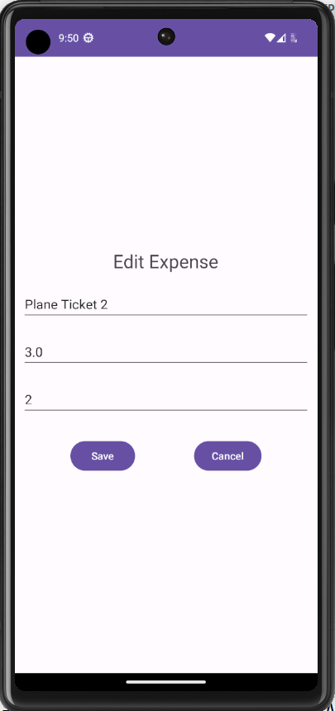
Navigation Between Screens
Expenses App
New Expense
How to make the following Expenses App :
Kotlin Code is written for the Adapter
Everytime, an expense is added, a refresh For the UI state is invoked.
Food at ABC
10/2023 10.0DZ
Gifts for Amel
10/2023 30.0DZ
Fuel for Car
10/2023 20.0DZ
Electricity Bill
10/2023 50.0DZ

Slide 64
Navigation Between Screens
Expenses App
New Expense
How to make the following Expenses App :
New Activity for the EditExpense (XML+Kotlin)
Upon Clicking an Item on the ListView Create an intent to launch the Activity
Inside the Child Activity (EditExpense), Using the passed data inside the intent, We fill the form
Food at ABC
10/2023 10.0DZ
Gifts for Amel
10/2023 30.0DZ
Fuel for Car
10/2023 20.0DZ
Electricity Bill
10/2023 50.0DZ

Slide 65
Navigation Between Screens
Expenses App
New Expense
How to make the following Expenses App :
Registering the Event on every Expense Item
New Activity for the EditExpense (XML+Kotlin)
Upon Clicking an Item on the ListView Create an intent to launch the Activity
Inside the Child Activity (EditExpense), Using the passed data inside the intent, We fill the form
Food at ABC
10/2023 10.0DZ
Gifts for Amel
10/2023 30.0DZ
var lv_expenses=findViewById<ListView>(R.id.lv_expenses)
lv_expenses.setOnItemClickListener { parent, view, position, id ->
println("Item Clicked at Position "+position+" with ID : "+id+" "+data.get(position).name)
val intent = Intent(this, EditExpense::class.java)
intent.putExtra("expense_index", position)
launchActivityNewExpense.launch(intent)
}
Fuel for Car
10/2023 20.0DZ
Electricity Bill
10/2023 50.0DZ

Slide 66
Navigation Between Screens
Expenses App
New Expense
How to make the following Expenses App :
Getting data via intent
Food at ABC
10/2023 10.0DZ
override fun onCreate(savedInstanceState: Bundle?) {
super.onCreate(savedInstanceState)
setContentView(R.layout.activity_edit_expense)
val extras = intent.extras
if (extras != null) {
position_id = extras.getInt("position_id")
expense=MainActivity.data.get(position_id) as Expense
var tx_name=findViewById<EditText>(R.id.tx_description)
var tx_date=findViewById<EditText>(R.id.tx_date)
var tx_price=findViewById<EditText>(R.id.tx_amount)
tx_name.setText(expense!!.name)
tx_date.setText(expense!!.date)
tx_price.setText(""+expense!!.price)
}
Gifts for Amel
10/2023 30.0DZ
Fuel for Car
10/2023 20.0DZ
Electricity Bill
10/2023 50.0DZ

Slide 67
Navigation Between Screens
Expenses App
New Expense
How to make the following Expenses App :
Saving Data …
Food at ABC
10/2023 10.0DZ
var bt_save=findViewById<Button>(R.id.bt_save)
bt_save.setOnClickListener {
expense?.name=findViewById<EditText>(R.id.tx_description).text.toString()
expense?.date=findViewById<EditText>(R.id.tx_date).text.toString()
expense?.price=findViewById<EditText>(R.id.tx_amount).text.toString().toDouble()
val intent = Intent()
this.setResult(RESULT_OK, intent)
this.finish()
}
Gifts for Amel
10/2023 30.0DZ
Fuel for Car
10/2023 20.0DZ
Electricity Bill
10/2023 50.0DZ

Slide 68
Threads in Android Mobile Apps
Question :
How to improve the App Incrementer so that It would keep incrementing the number Every 1 second ? Without the need to keep Clicking ?

Slide 69
Threads in Android Mobile Apps
override fun onCreate(savedInstanceState: Bundle?) {
super.onCreate(savedInstanceState)
setContentView(R.layout.activity_main)
var bt_start=findViewById<Button>(R.id.bt_start)
bt_start.setOnClickListener {
if (!is_running) {
startCounting()
bt_start.setText("Stop Running")
is_running=true
}else{
bt_start.setText("Start")
is_running=false
}
}
}
Question :
How to improve the App Incrementer so that It would keep incrementing the number Every 1 second ? Without the need to keep Clicking ?

Slide 70
Threads in Android Mobile Apps
private fun startCounting(){
var tx_counter=findViewById<TextView>(R.id.tx_counter)
var handler = Handler(Looper.getMainLooper())
val runnable =object : Runnable{
override fun run() {
if (!is_running)return
increment = increment + 1
tx_counter.setText("" + increment)
handler.postDelayed(this, 1000)
}
}
handler.postDelayed(runnable, 1000)
}
Question :
How to improve the App Incrementer so that It would keep incrementing the number Every 1 second ? Without the need to keep Clicking ?

Slide 71
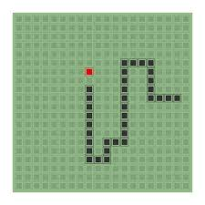
Section 2
Android Game : Snake

Slide 72
Example for Mobile App : Snake Game
Steps to get Started (After creating the project…):
Create the Board UI
Use XML for the basic UI components including the buttons
Create the Layout for the Widgets of the grid
Dynamically generate the Grid.
Initialize the snake with three adjacent cells with different color.
Initialize the the food cell with the color red.
Register Event Listeners for the four arrow buttons
Start moving the snake.
If the snake head hits a wall ( gets outside the grid) or hits itself, just say, game over
If the snake hits a food cell, grow the snake and generate randomly another food cell.

Slide 73
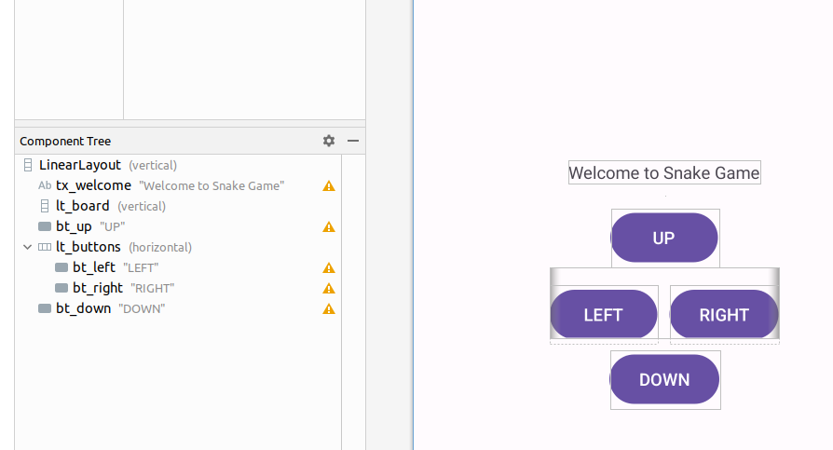
Example for Mobile App : Snake Game
Create the Board UI :
Use XML for the basic UI components including the buttons
Create the Layout for the Widgets of the grid
Dynamically generate the Grid.
1

Slide 74
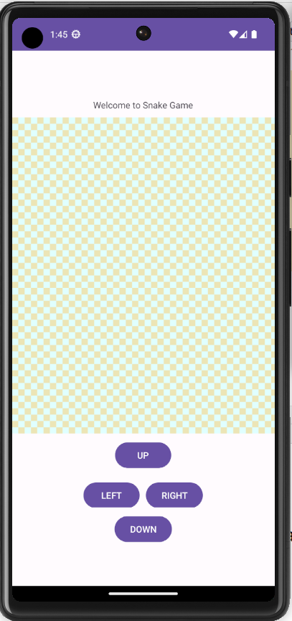
Example for Mobile App : Snake Game
Create the Board UI :
Use XML for the basic UI components including the buttons
Create the Layout for the Widgets of the grid
Dynamically generate the Grid.
1

Slide 75
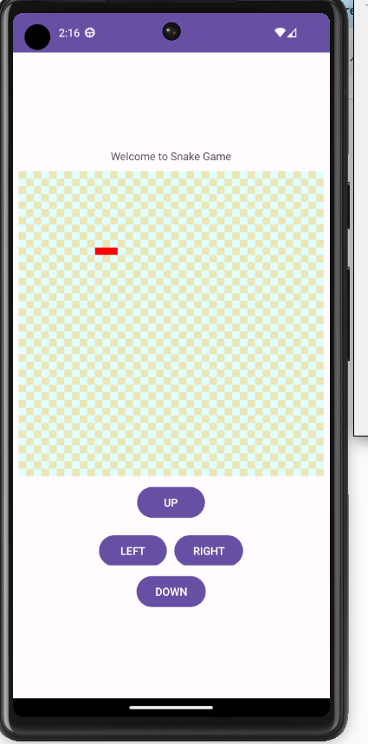
Example for Mobile App : Snake Game
Initialize the snake with three adjacent cells with different color:
var snakeCells= Vector<String>()
private fun initSnake(){
snakeCells.removeAllElements()
snakeCells.add("10x10")
snakeCells.add("10x11")
snakeCells.add("10x12")
var cell= board_data[10]?.get(10) as TextView
cell.setBackgroundColor(Color.parseColor("#ff0000"))
cell= board_data[10]?.get(11) as TextView
cell.setBackgroundColor(Color.parseColor("#ff0000"))
cell= board_data[10]?.get(12) as TextView
cell.setBackgroundColor(Color.parseColor("#ff0000"))
}
2

Slide 76
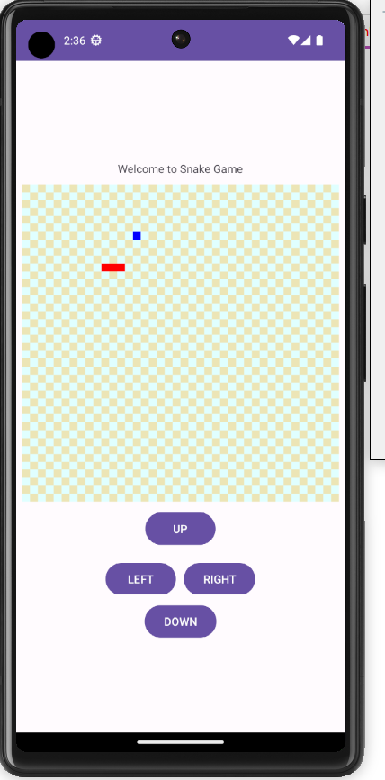
Example for Mobile App : Snake Game
Initialize the snake food at some random location
3
var food_row:Int=0
var food_col:Int=0
private fun generateFood(){
food_row=(0..boardSize-1).random()
food_col=(0..boardSize-1).random()
var cell= board_data[food_row]?.get(food_col) as TextView
cell.setBackgroundColor(Color.parseColor("#0000ff"))
}

Slide 77
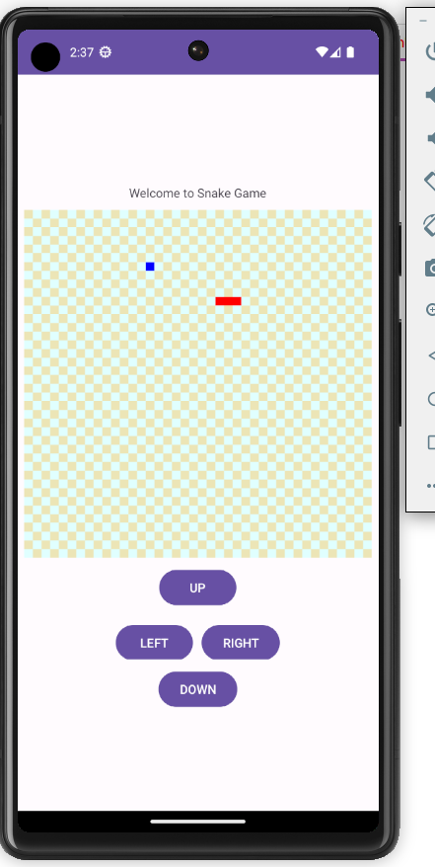
Example for Mobile App : Snake Game
Register Event Listeners ? Let’s keep it simple for now
Register Event Handler to the four button to:
Assign a direction inside a given variable
direction =’right’
4
var bt_down=findViewById<Button>(R.id.bt_down)
bt_right.setOnClickListener {
direction="down"
}

Slide 78
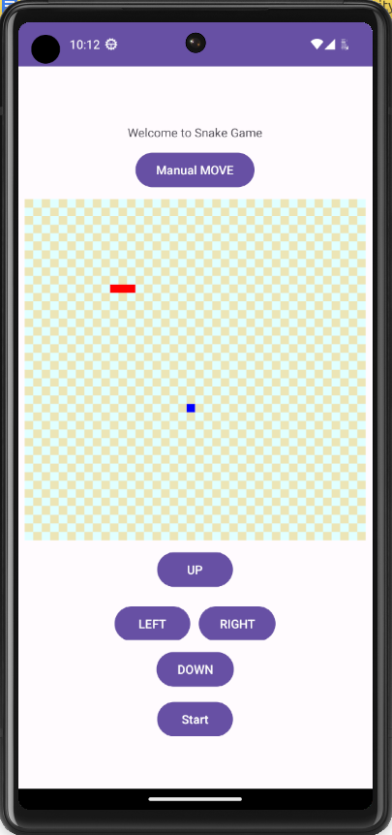
Example for Mobile App : Snake Game
Moving the Snake
To make it easier to understand, let’s create a button to manually Move the snake
5
var bt_manual=findViewById<Button>(R.id.bt_manual)
bt_manual.setOnClickListener {
moveSnake()
}

Slide 79
Example for Mobile App : Snake Game
What does it do ?
var head_row=10
var head_col=12
var tail_row=10
var tail_col=10
fun moveSnake(){
head_col=head_col+1
var cell= board_data[head_row]?.get(head_col) as TextView
cell.setBackgroundColor(Color.parseColor("#ff0000"))
//Remove Old tail.
restoreCellOfGrid(tail_row,tail_col)
tail_col=tail_col+1
}
private fun restoreCellOfGrid(row:Int,col:Int){
var cell= board_data[row]?.get(col) as TextView
if (row % 2 == col %2) {
cell.setBackgroundColor(Color.parseColor("#ECE5B6"))
} else {
cell.setBackgroundColor(Color.parseColor("#E0FFFF"))
}
}
Moving the Snake
To make it easier to understand, let’s create a button To manually Move the snake
5

Slide 80
Example for Mobile App : Snake Game
fun moveSnake(){
var headVals=snakeCells.get(snakeCells.size-1).split("x")
var tailVals=snakeCells.get(0).split("x")
var head_row=headVals[0].toString().toInt()
var head_col=headVals[1].toString().toInt()
var tail_row=tailVals[0].toString().toInt()
var tail_col=tailVals[1].toString().toInt()
if (direction=="right") head_col = head_col + 1
if (direction=="left") head_col = head_col - 1
if (direction=="down") head_row = head_row + 1
if (direction=="up") head_row = head_row - 1
if ( head_col<0 || tail_col <0 || head_row <0 || tail_row<0 ||
head_col>=boardSize || tail_col>=boardSize || head_row>=boardSize || tail_row>=boardSize)
return
snakeCells.add(""+head_row+"x"+head_col)
var cell= board_data[head_row]?.get(head_col) as TextView
cell.setBackgroundColor(Color.parseColor("#ff0000"))
snakeCells.removeElementAt(0) restoreCellOfGrid(tail_row,tail_col)
}
Register Event Listeners ? Let’s keep it simple for now
Register Event Handler to the four button to:
Assign a direction inside a given variable
direction =’right’
5

Slide 81
Example for Mobile App : Snake Game
Start Moving the Snake CONTINUOUSLY ?
5

Slide 82
Example for Mobile App : Snake Game
Start Moving the Snake CONTINUOUSLY ?
Back to the App for incrementing a number
5

Slide 83
Example for Mobile App : Snake Game
Eats Food
Detects when the game is over
6+7
Needs to be done before the LAB

Slide 84
Lecture Demo Apps
Making a colored grid
https://www.dropbox.com/scl/fo/hebymwpva5d40090i5cie/h?rlkey=18rt161d8pz86pogzms9heldm&dl=0
Simple Expense App without a database
https://www.dropbox.com/scl/fo/92u3kh2tnxcpuovy4l6aq/h?rlkey=3juzowohcivh402x8b5nwv4gq&dl=0
Auto Incrementing App
https://www.dropbox.com/scl/fo/jws84rvm41k8g6mlqnt4m/h?rlkey=avhr5i8rwogrkkgnolx6xy0yg&dl=0
Snake Game
https://www.dropbox.com/scl/fo/ecjqgaip264x3222ob11v/h?rlkey=qsv6z2xtgzzpvj9de87sfgbyf&dl=0

Slide 85
Resources
https://developer.android.com/reference/android/os/Handler.html#postDelayed(java.lang.Runnable,%20long)
https://www.geeksforgeeks.org/android-listview-in-kotlin/
https://developer.android.com/codelabs/basic-android-kotlin-training-activities-intents?continue=https%3A%2F%2Fdeveloper.android.com%2Fcourses%2Fpathways%2Fandroid-basics-kotlin-unit-3-pathway-1%23codelab-https%3A%2F%2Fdeveloper.android.com%2Fcodelabs%2Fbasic-android-kotlin-training-activities-intents#0

Slide 86
Type the size of the board:
1 | 2 | 3 | 4
5 | 6 | 7 | 8
9 | 10 | 11 | 12
13 | 14 | 15
5
Generate Puzzle
You win

